Slide 1
Bedroom
15’-8”x 9’-8”
Full
Bathroom
8’-2” x 10’-4”
Master
14’x10’
½ Bath 4’11”x4’7”
Living Room
Bedroom
10’-3”x 12’-12”-4”
Kitchen
14’9”x11’
13’x 27’4”
Dining
9-7”’x 14’-7”
Game Area
Geneva Lane
Fontana, WI
Main Level
* Not to scale
* Approximate Dimensions
Closet
Side Entry
Front Door Entry

Slide 2
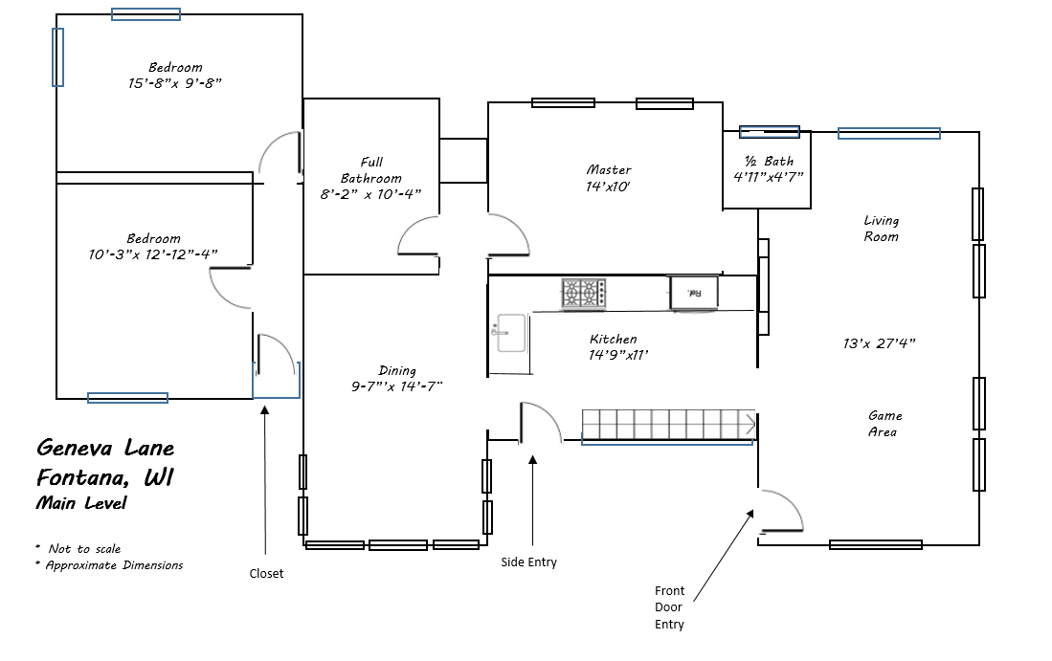
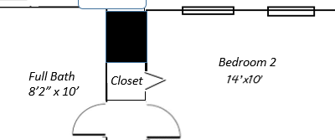
Master Bedroom Suite
9’-½” x 9’
13’-3”x 12’
Closet
Bedroom 2
Full Bath
8’2” x 10’
Closet
Closet
15 x 10-3”
Bedroom 1
BB
9’-10 x 10
Fontana Ridge
Fontana, WI
Front Porch

Slide 3
80”
61”x22” 5’08” x 1’8” double vanity
85”
36”
3’ door swing
42”

